Slide 1
West Nile Virus
In Chicago
A status update to members of Centre for Disease Control and Prevention (CDC)
5pm Disease and Treatment Agency
By: Adriel Chen
Andrew Chia
Estebelle Khong
Tay Yi Li

Slide 2
Agenda
01
02
03
04
Background and Problem Statement
Exploratory Data Analysis
Modelling and Evaluation
Cost-Benefit Analysis, Conclusion and Recommendation

Slide 3
01
Background and Problem Statement

Slide 4
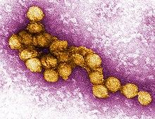
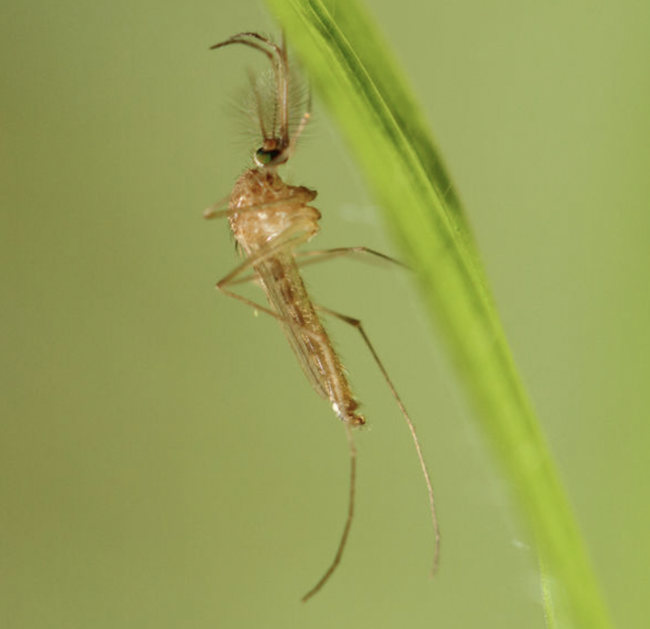
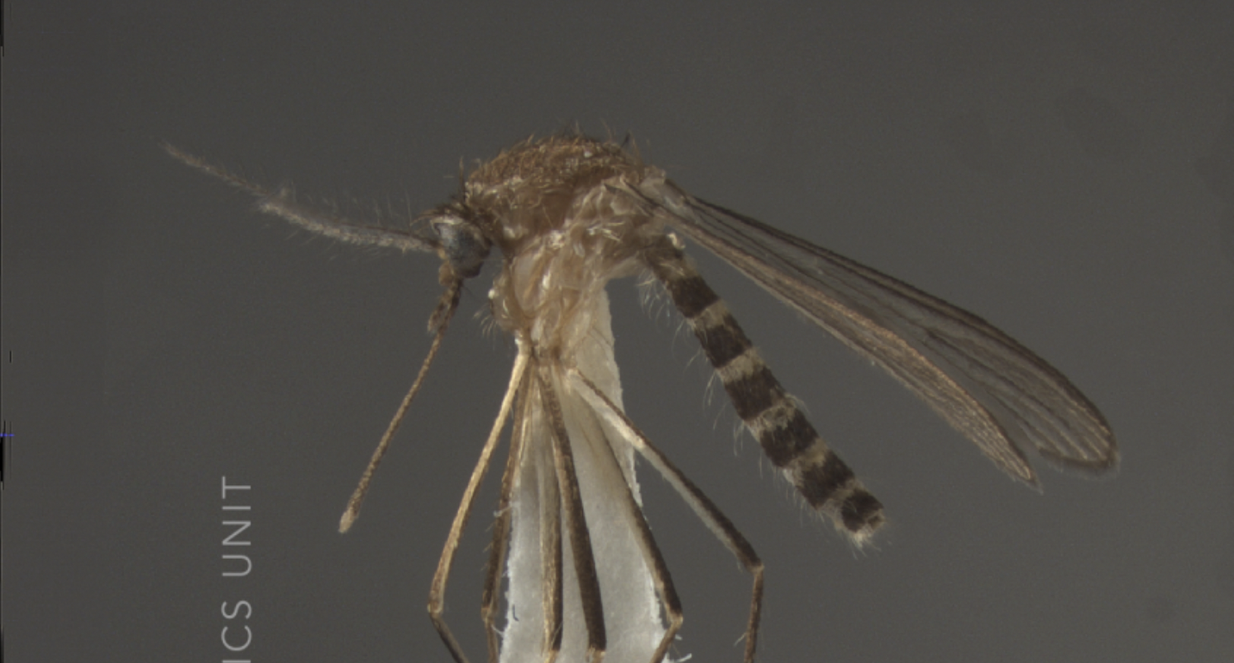
What is West Nile Virus?
A single-stranded RNA virus that causes West Nile fever.
3. Transmission
Flaviviridae Family
Bird -> Mosquitoes -> Human
2 common mosquito types:
Family also includes Zika, dengue, and yellow fever.
Culex Pipiens
Culex Restuans
2. Host: Birds
Virus is found in more than 250 species of birds, especially crows, jays, and ravens.
4. Likely Place of Transmission
5. Symptoms?
Mammals, especially Human and Horse are likely to develop a flu-like illness or signs of neurologic disease.
Place where birds and human will gather, like farmer markets.

Slide 5
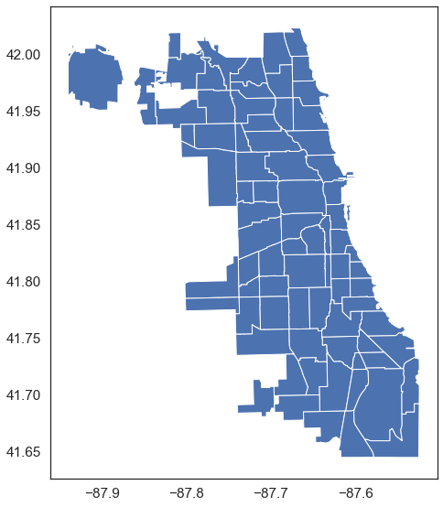
West Nile Virus Situation in US
An Israeli strain of virus emerged in New York city in fall of 1999.
Maybe introduced by infected mosquito via air/sea transport
Or through migration of infected wild birds.
Then, transmitted throughout US by migrating birds.
In 2002, West Nile Virus reached Chicago for the 1st Time ! 225 human cases reported that summer.

Slide 6
Problem Statement
“This projects aim to use data science methods (classification modellings) to predict the places in Chicago where the West Nile Virus is present, with prediction having the higher AUC performance the better (as close to 1 as possible), so as to enable a more accurate and effective plan in deploying pesticides spraying throughout the state.”

Slide 7


Datasets We Used
Main dataset
Spray dataset
Weather dataset
Records the location of mosquito traps set up, and whether West Nile Virus is present
Records the date, time and location where the spraying of mosquitoes is conducted.
Records the weather condition in Chicago from 2 stations.
Time Range:
Sep 2011
Jul-Sep 2013
Time Range:
May to Oct
2007-2014
Train
Test
Time Range:
May to Oct 2007/09/11/13
Time Range:
June to Oct 2008/10/12/14

Slide 8
Workflow Outline
Step 1
Step 2
Step 3
Step 4
EDA
Modelling and Evaluation
Cost- Benefit Analysis
Conclusions
and Recommendations

Slide 9
02
Exploratory Data Analysis

Slide 10
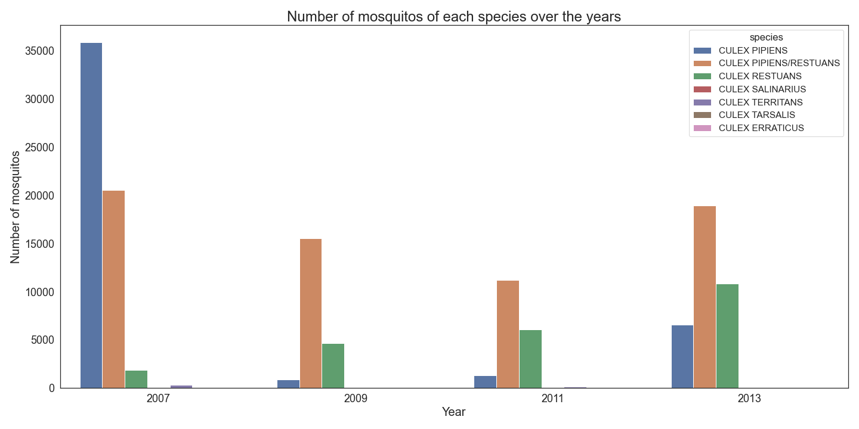
EDA: Overview of Mosquito Data from dataset
Overall, Culex Pipiens and Restuans are the dominant species

Slide 11
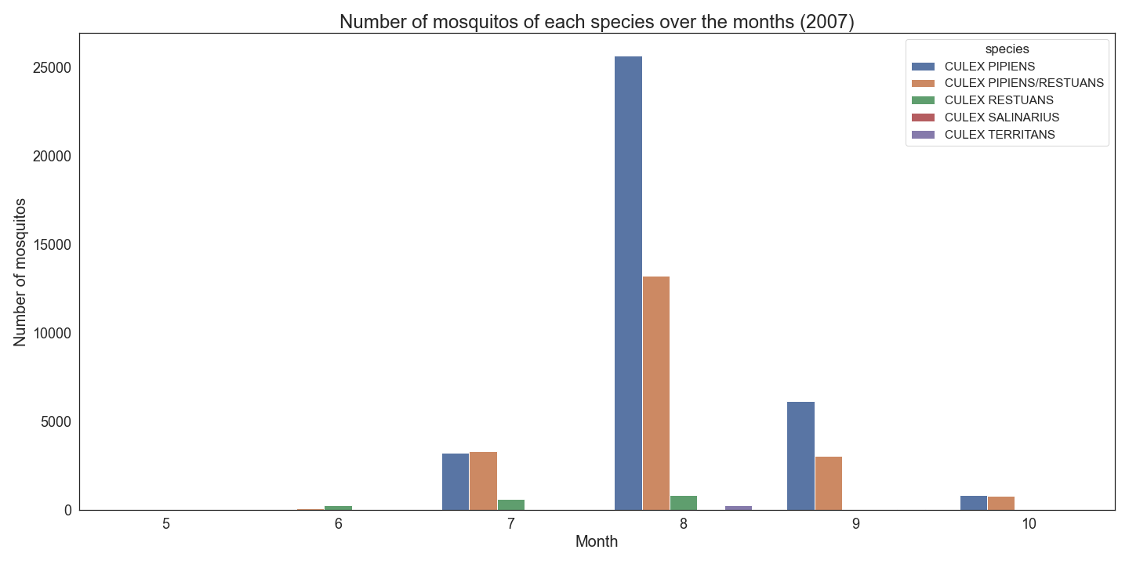
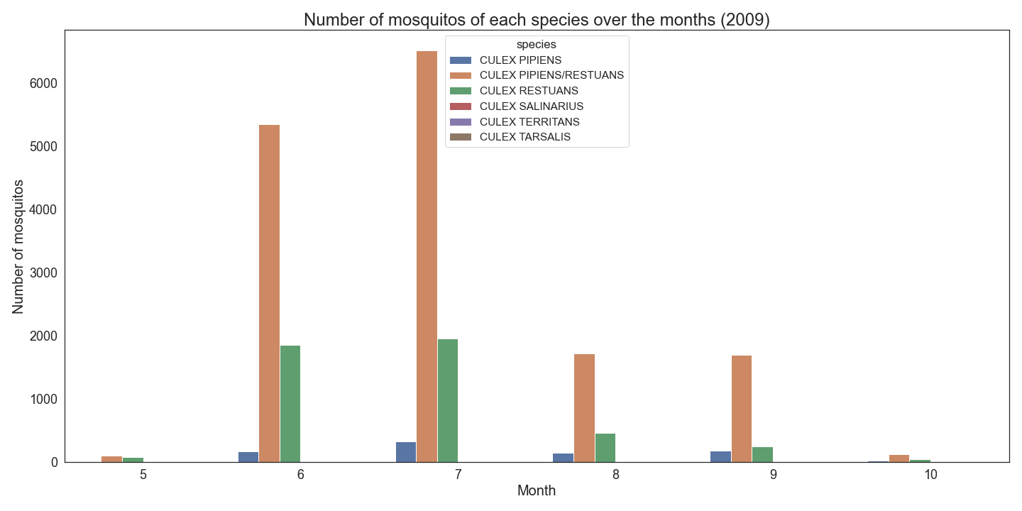
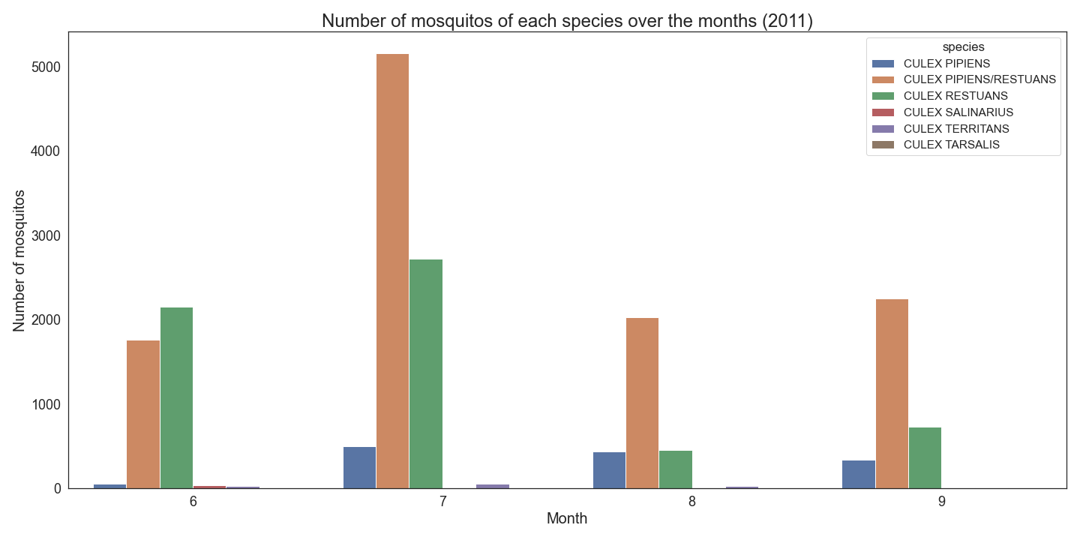
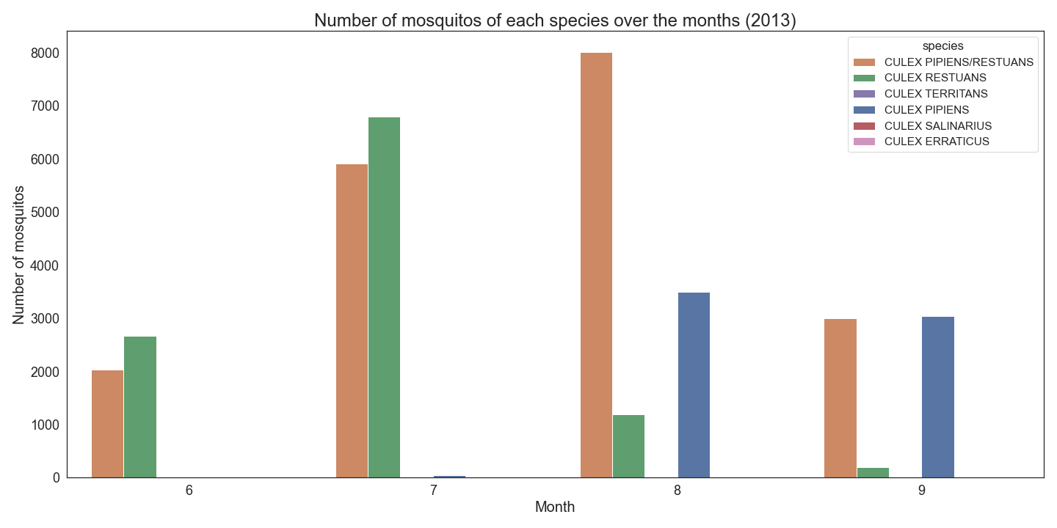
EDA: Mosquito appearance over the years
2007
2009
2011
2013

Slide 12
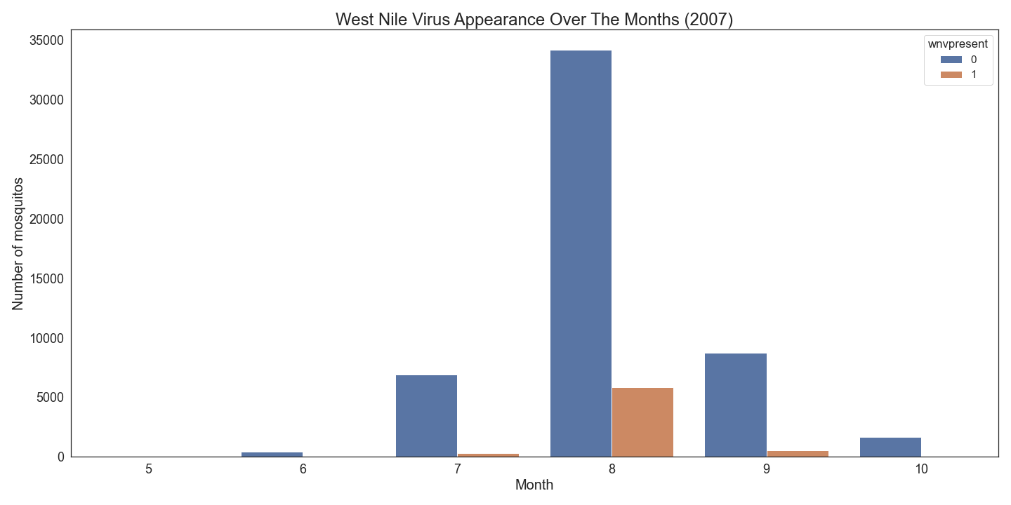
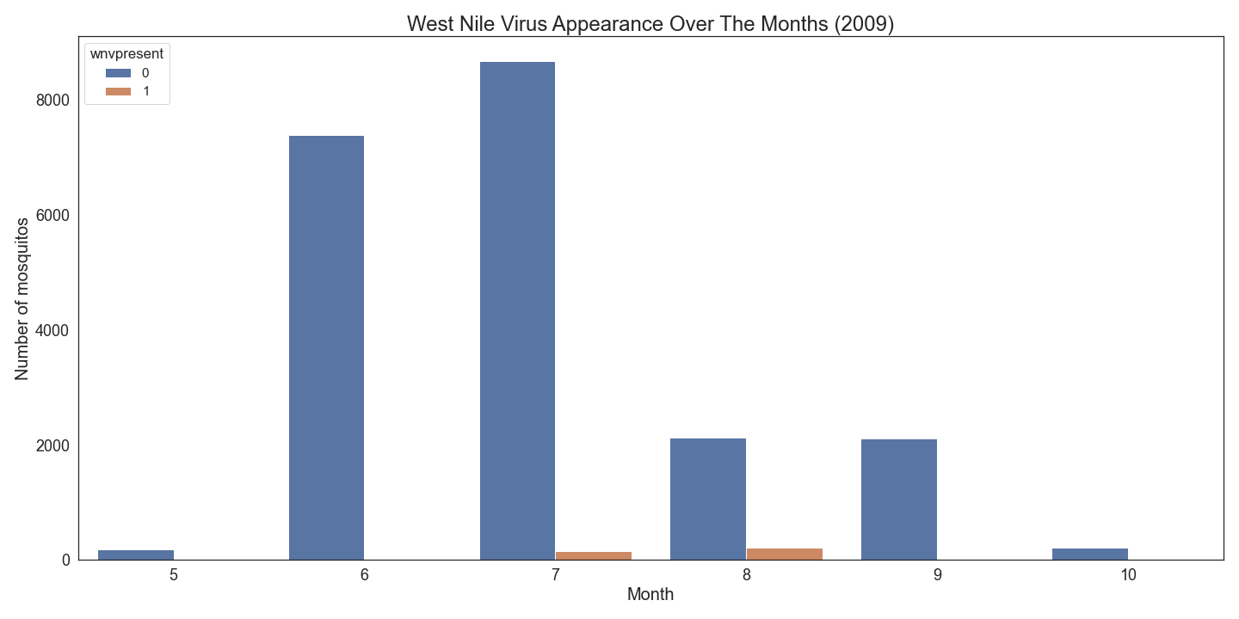
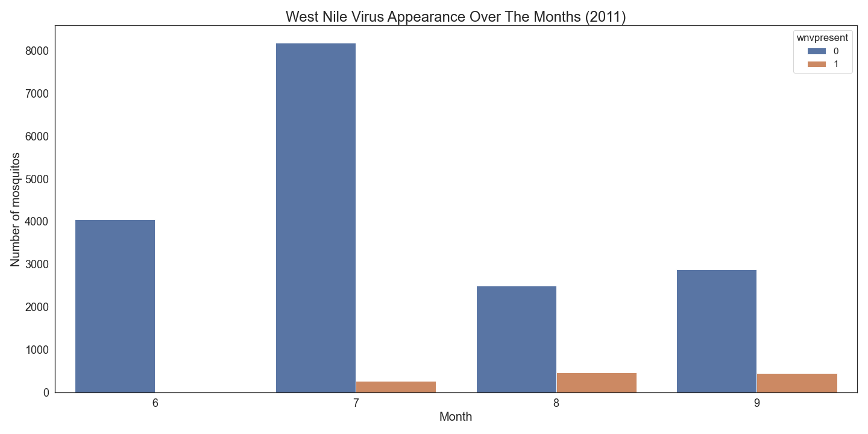
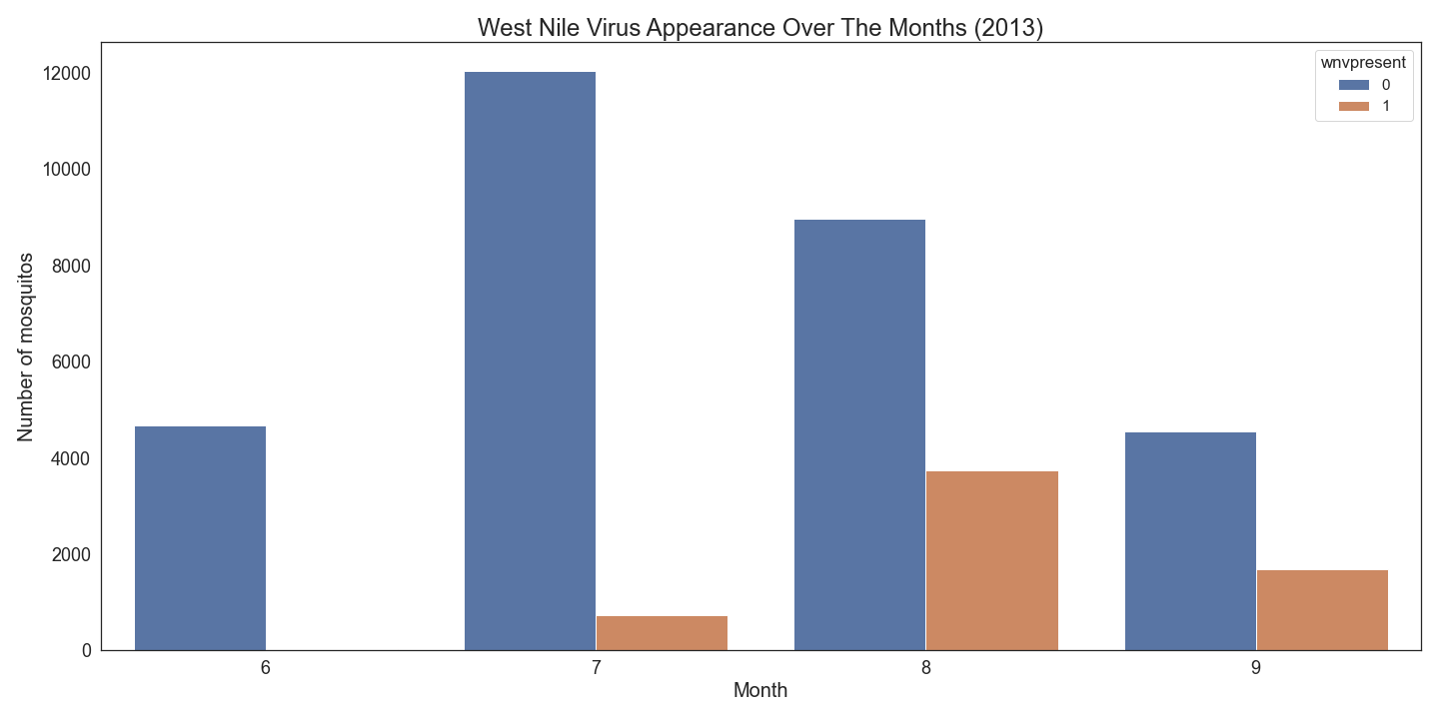
EDA: West Nile Virus appearance over the years
2007
2009
2011
2013

Slide 13
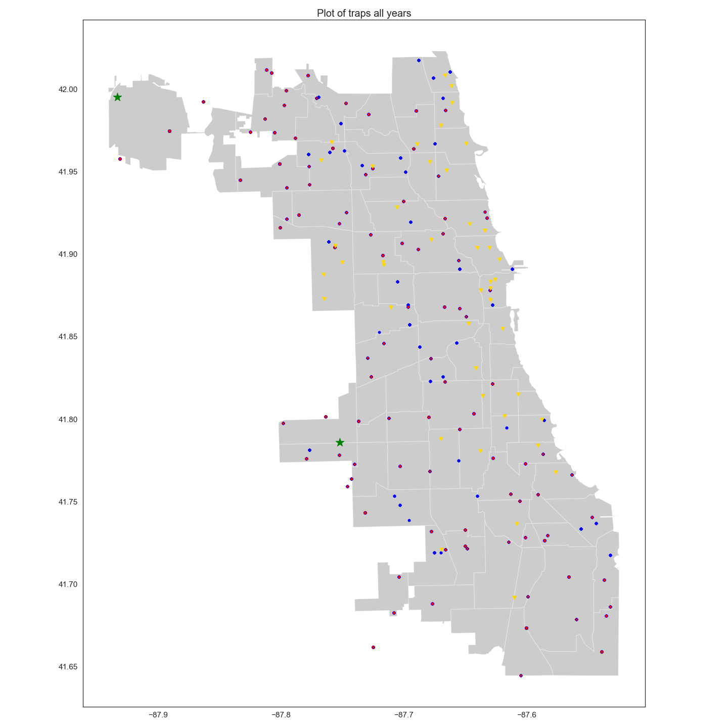
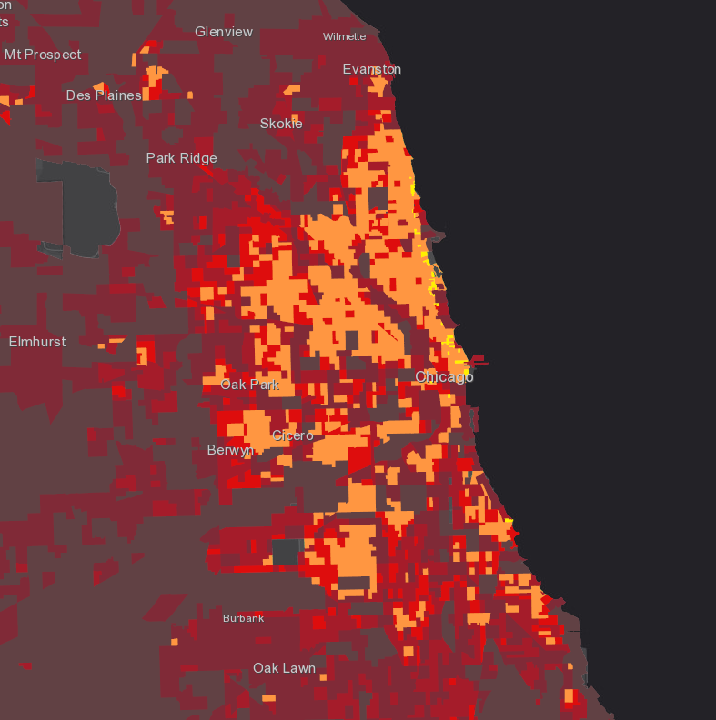
EDA: Mapping of traps and population density
Highest Density
Very High Density
High Density
Medium Density
Low Density
Weather Station
WNV Positive
WNV Negative
Farmer Markets
Lack of traps in highest density areas
Lack of traps near farmer markets

Slide 14
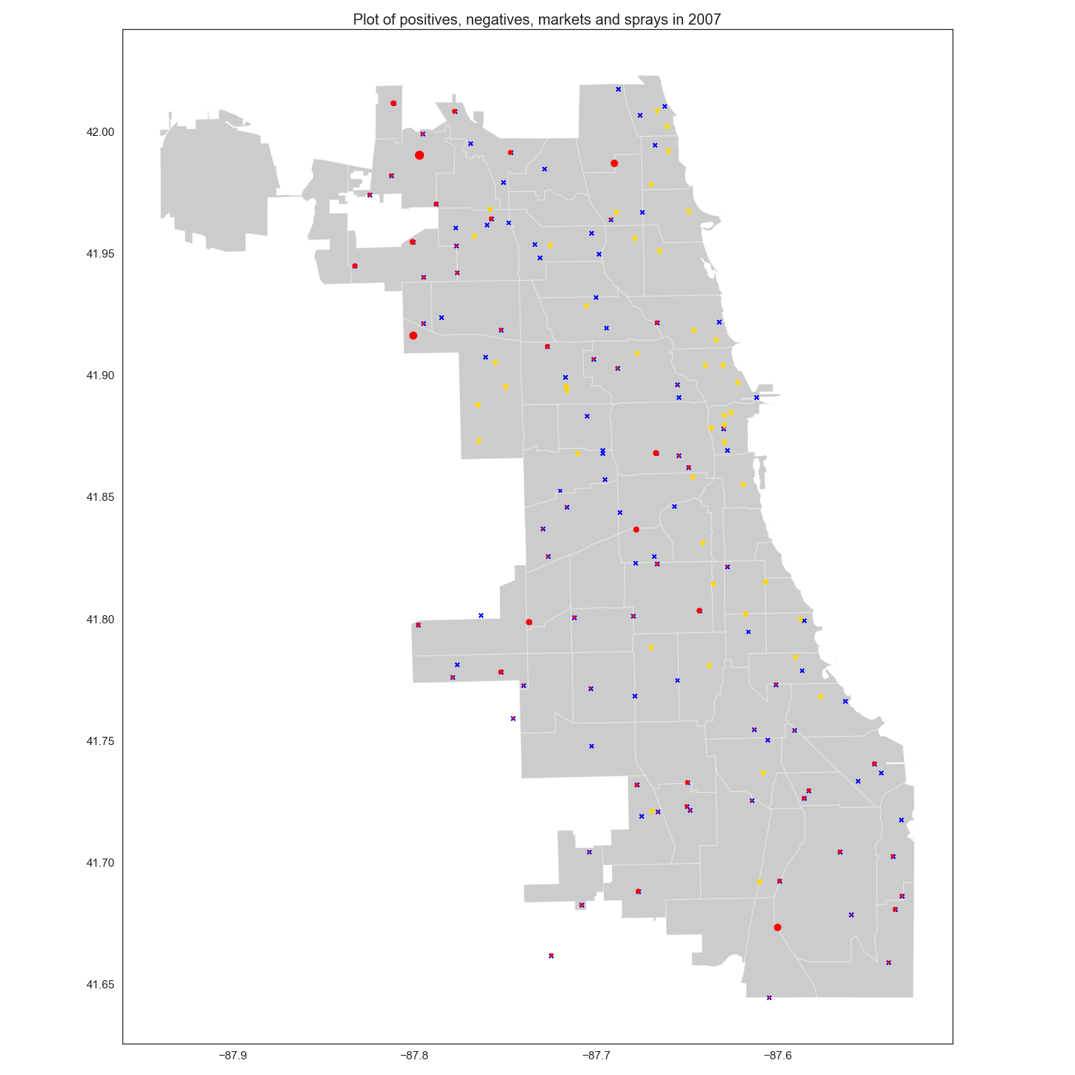
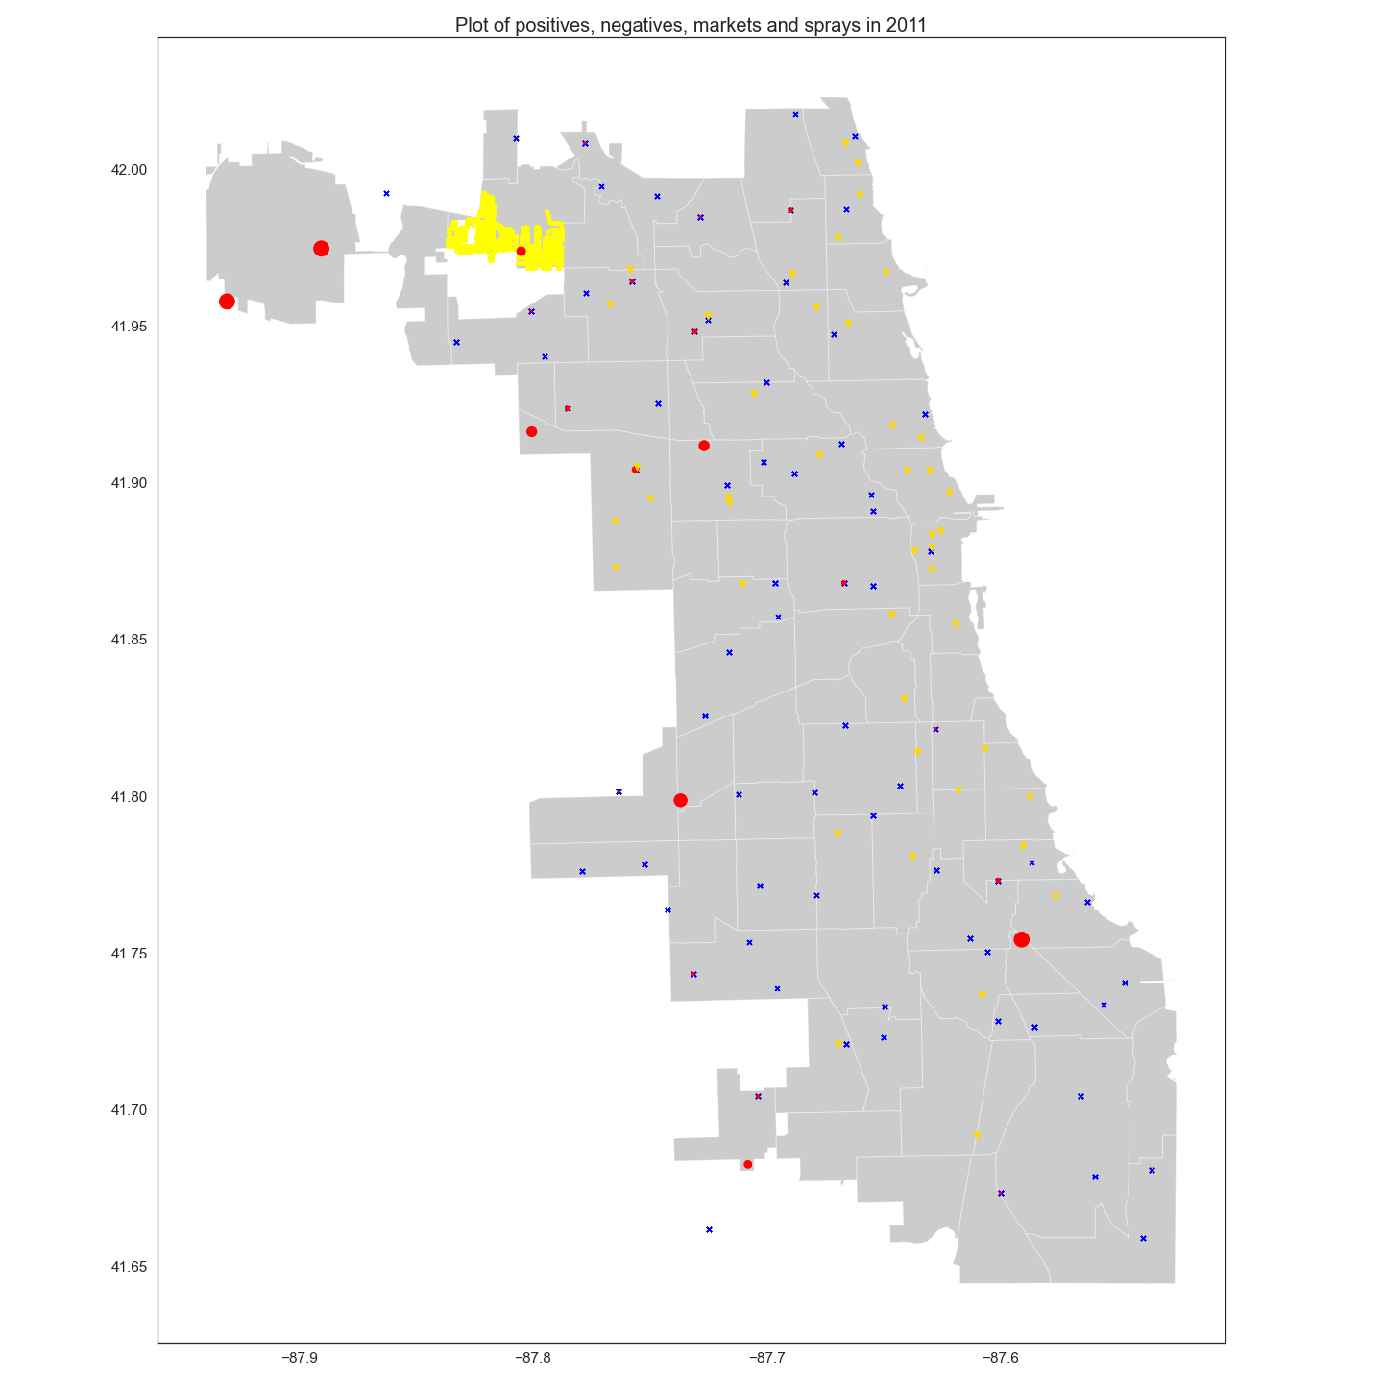
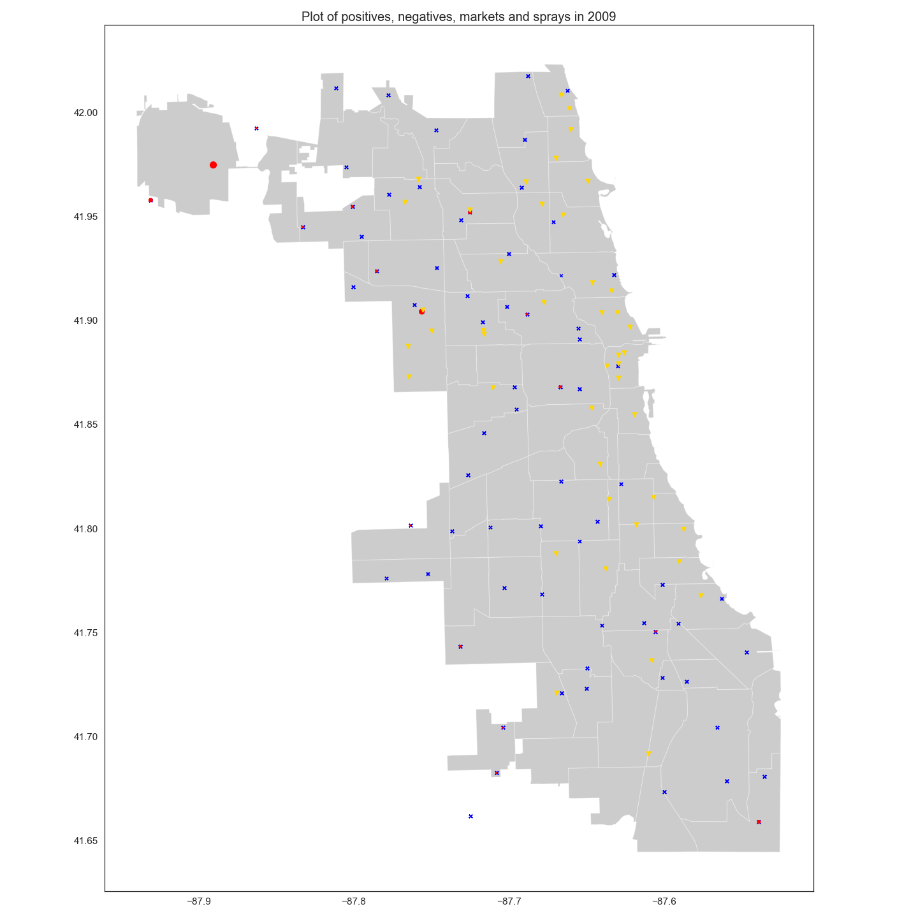
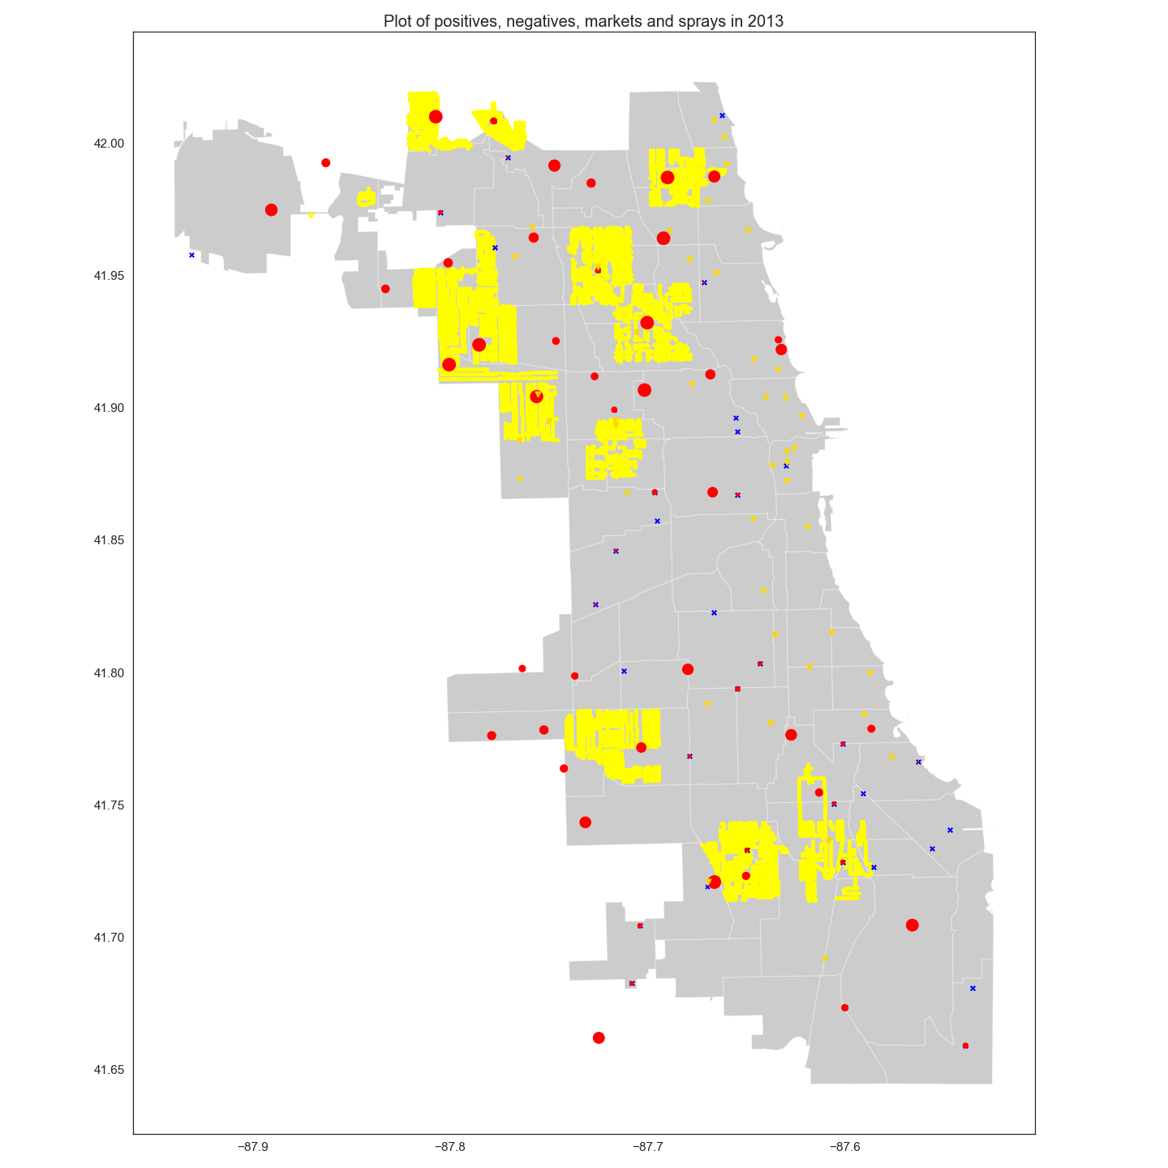
Mapping of WNV Appearance and Spraying
2007
2009
2011
2013
WNV Positive
WNV Negative
Farmer Markets
Sprayed

Slide 15
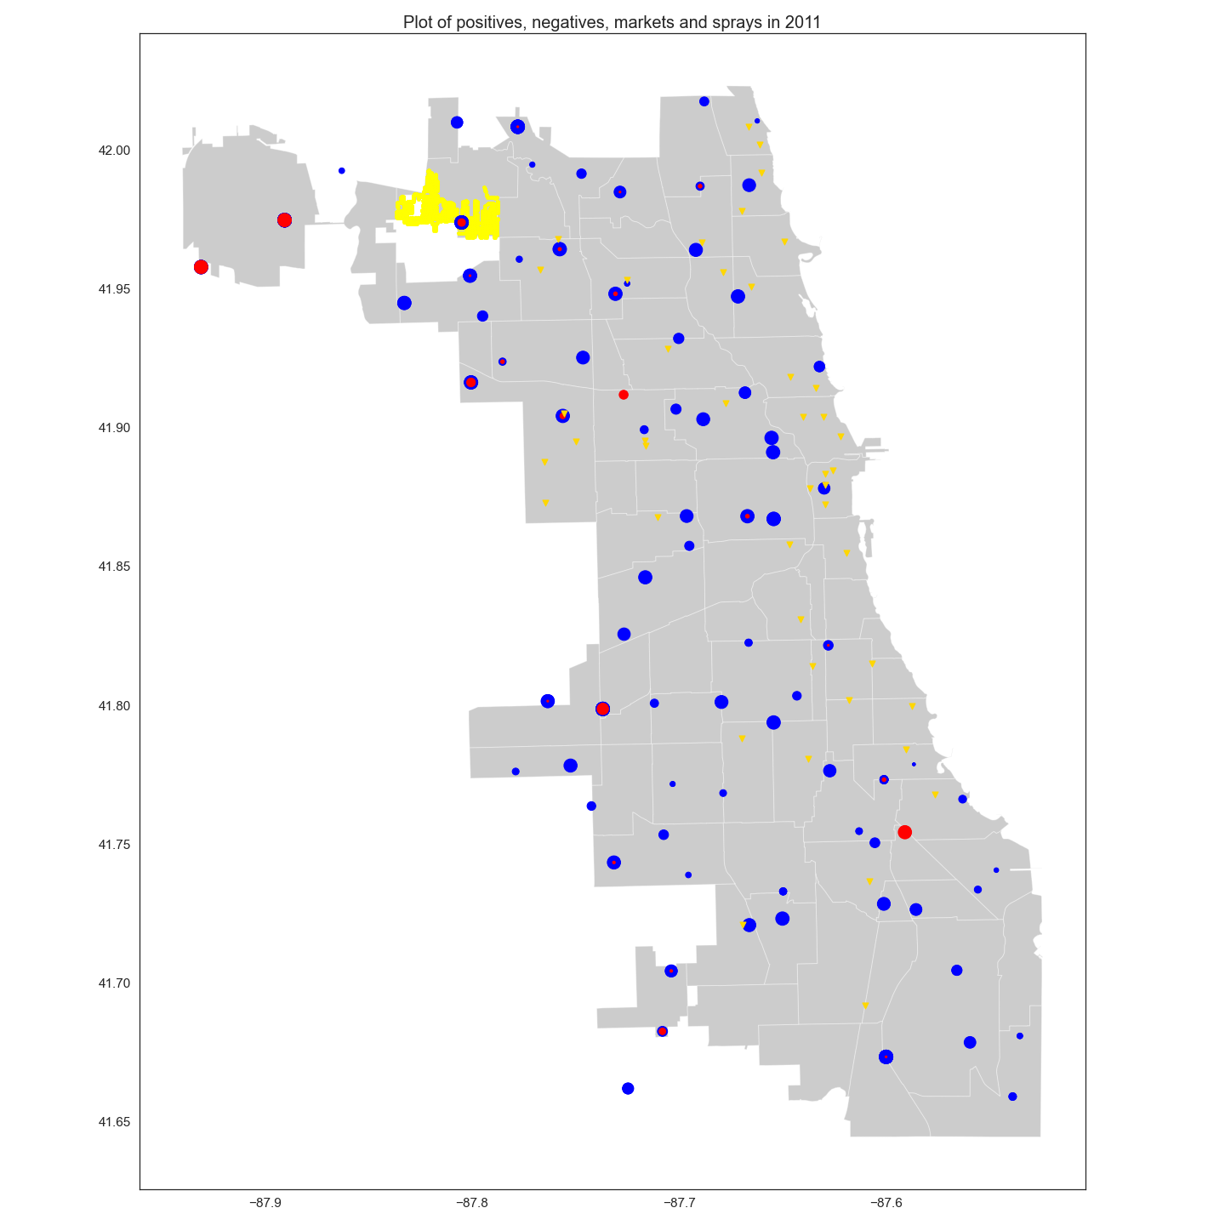
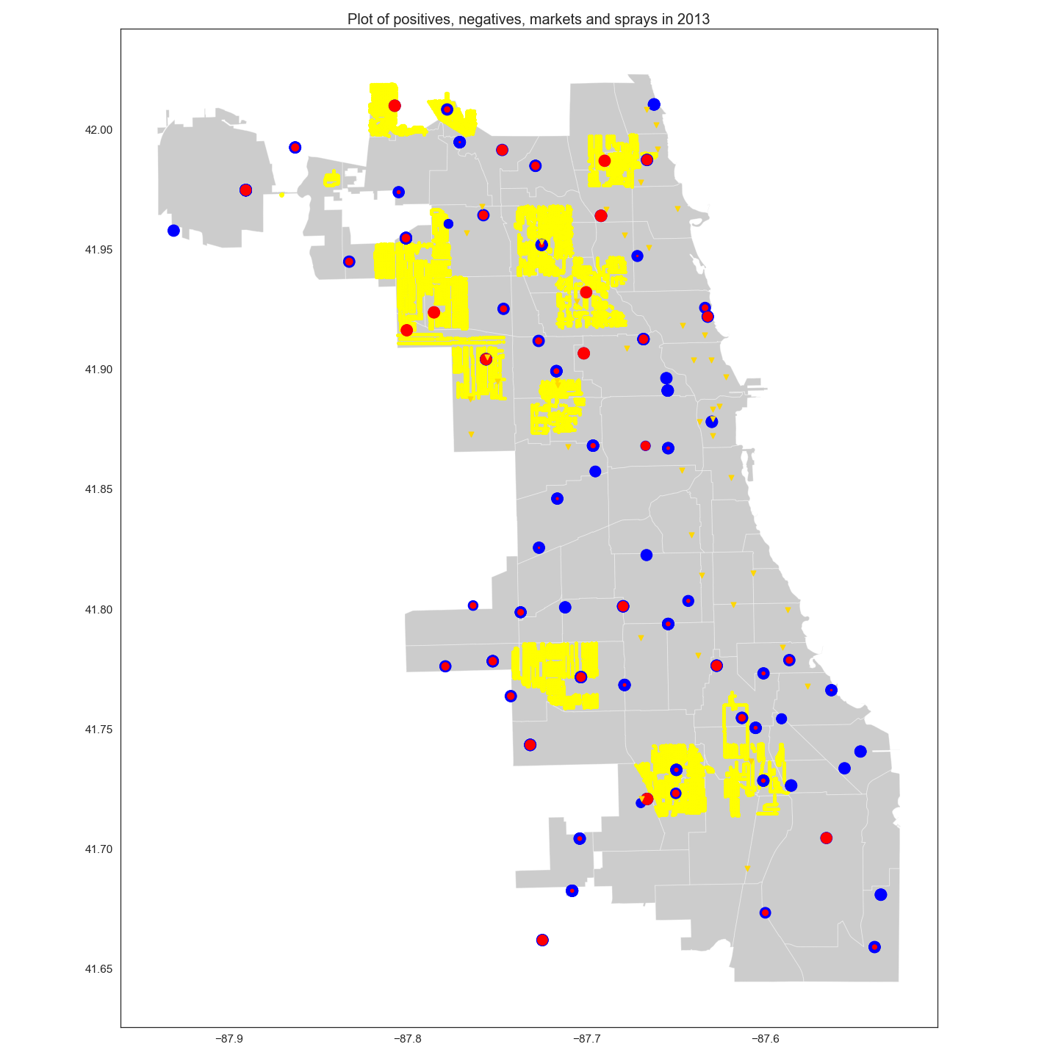
Mapping of Mosquito Appearance and Spraying
2011
2013
WNV Positive
WNV Negative
Farmer Markets
Sprayed

Slide 16
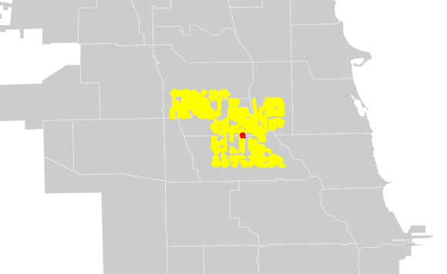
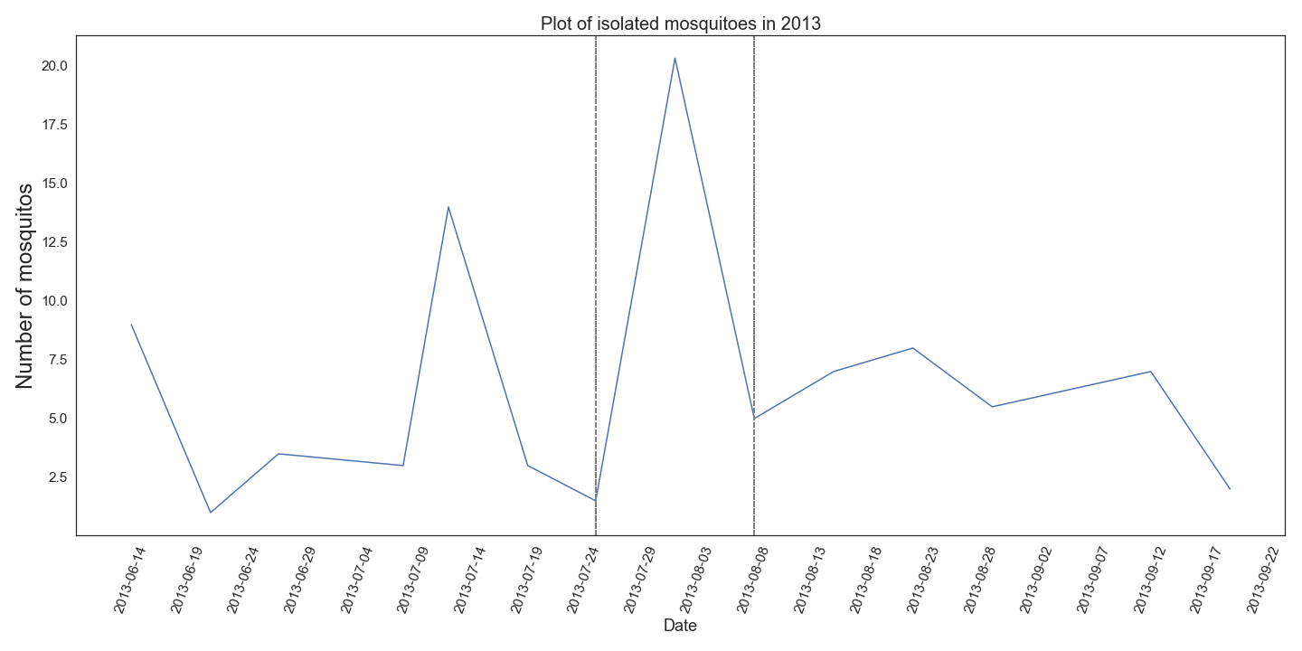
EDA: Effectiveness of spraying

Slide 17
03
Model Evaluation
Notes:
Models analyse the data collected at each area and predicts whether the virus is present there

Slide 18
Baseline
95% Accuracy
Predict: No West Nile Virus
Notes:
- Baseline: 95% Accuracy, very high, how did we get it?
- Used the proportion of majority class in dataset → i.e. in this case, means we predict that there is no West Nile Virus regardless of data collected and we are correct 95% of the time
- not a good baseline to follow despite extremely high accuracy score, next slide will discuss why this is so

Slide 19
Project’s Purpose..
..but the Baseline..
Evaluate data collected
Identify places with West Nile Virus
Deploy pesticides
Ignores collected data
Predicts no West Nile Virus
No pesticides will be deployed
Notes:
- recall purpose of the project: evaluate data collected, correctly predict and identify places that actually have West Nile Virus present, deploy pesticides to kill the mosquitos and prevent spreading of virus (virus can be fatal)
- but our baseline seems to do the exact opposite: ignores all data collected, predicts there is no virus regardless of the data, and as a result no pesticides will be deployed → virus will just keep spreading
- any model that is able to correctly predict even 1 area that has the West Nile Virus beats the baseline
- aside from this, the baseline helped us understand that Accuracy score should not be the metrics used for model evaluation, we will explore why this is so in the next slide

Slide 20
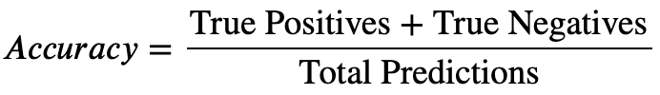
Accuracy score should not be main metric used for model evaluation
Overview of model’s ability to predict both majority and minority classes combined
Not good for extremely imbalanced datasets
High Accuracy score due to large number of correct predictions in majority class
Accuracy score masks model’s inability to correctly predict and classify minority class
Test and Train Accuracy to be compared to check for overfitting/underfitting
Notes:
What is accuracy
Basically an overview of the model’s ability to correctly predict both classes combined → both positive and negative, everything combined
the fact that Accuracy is calculated using both classes combined means it is not a good evaluation for extremely imbalanced datasets like the case in this project, why?
95% of data indicates that virus not present and 5% of virus present, the model will be trained in such a way that it is extremely good at predicting the majority class but cause of lack of info, very bad at minority class
Accuracy score returned is still very high because of the large number of correct predictions in the majority class
What this means is, when dealing with extremely imbalanced datasets, accuracy score masks the model’s inability to correctly predict minority class, it is misleading → instead, we compare the Accuracy to check for over/underfitting

Slide 21
Area Under Curve (AUC) and F1-score for evaluation
Area Under Curve (AUC)
Ability to distinguish between Positive (virus present) and Negative (virus not present)
Good model = High AUC
F1 score
Weighted average of Precision-Recall score, used to compare the performance of classifiers
Good model = High F1 score
Notes:
Instead of Accuracy, we will use AUC and F1 score as the evaluation metrics
AUC: the model’s ability to distinguish between the positive and negative class → in other words, the model’s ability to distinguish between whether the virus is present or not present. Higher AUC score = better
F1 score: put very simply, it is the weighted average of precision-recall score and is used to compare the performance of different classifiers/models. Higher F1 score = better

Slide 22
Models
Random Forest
Support Vector Classifier
AdaBoost
Gradient Boosting
Notes:
Models that we ran and will be comparing:
Random forest
Support vector classifier
Adaboost
Gradient boost
→ we will compare the AUC and F1 score between the models and check the Accuracies for under/overfitting

Slide 23
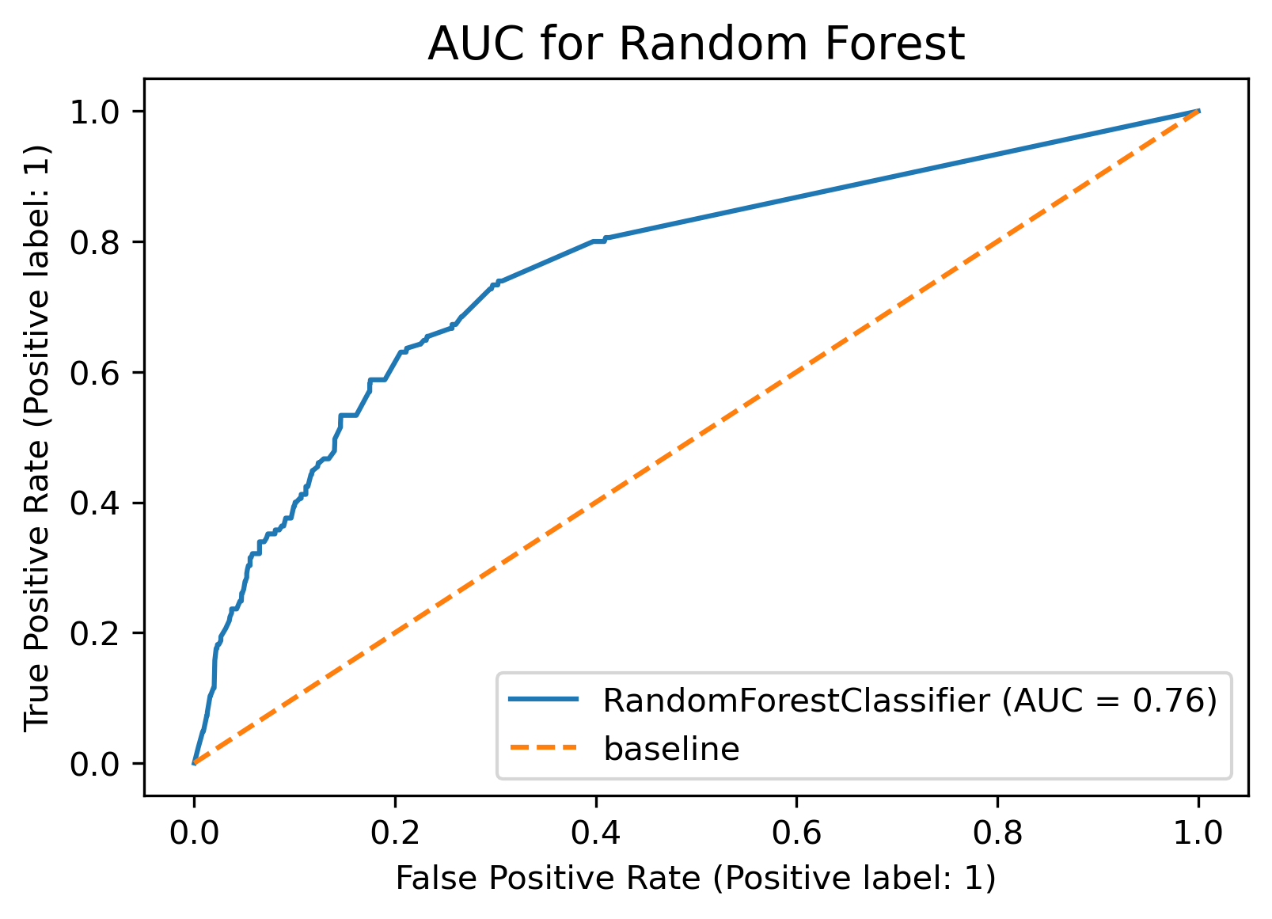
Random Forest
Area Under Curve
AUC closer to 1
Better at distinguishing between classes
Better Model
Notes:
Random forest:
Plotted the true positive rate and false positive rate to get the AUC and it is 0.76
Want it to be as close to 1 as possible → closer to 1 = better at distinguishing between classes = model is better
In this case, Random forest is an okay model, not bad but not excellent

Slide 24
Random Forest
31%
95%
94%
F1-score
Train Accuracy
Test Accuracy
Used to compare classifier performance
Train and Test Accuracy compared to check for overfitting/underfitting
Notes:
F1 score is 31% → not very high, we will need to see if the other models are able to beat this score
Next is Accuracy → Train and Test is similar, so the model is neither overfitted nor underfitted

Slide 25
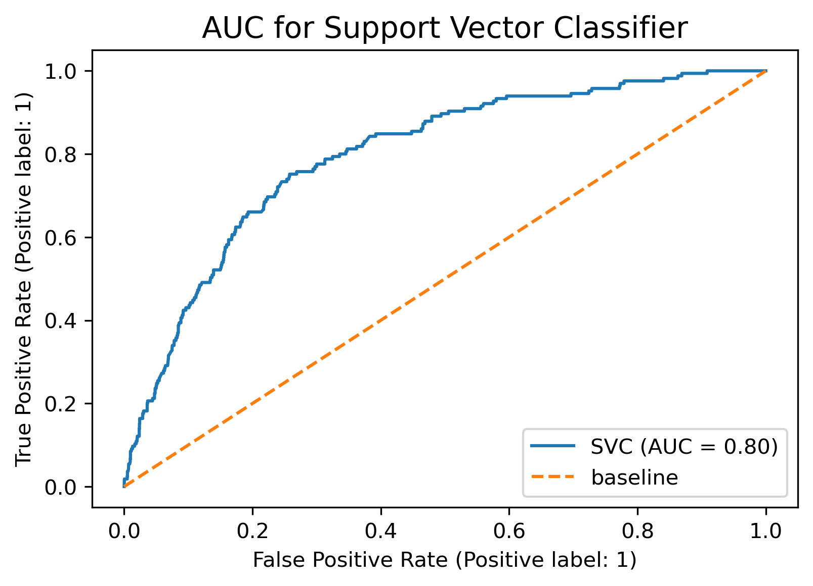
Support Vector Classifier
Area Under Curve
AUC closer to 1
Better at distinguishing between classes
Better Model
Notes:
Support vector classifier:
AUC should be as close to 1 aa possible, and the AUC for support vector is 0.8
Higher than random forest which was 0.79
Also not a bad model, its okay

Slide 26
Support Vector Classifier
29%
83%
95%
F1-score
Train Accuracy
Test Accuracy
Used to compare classifier performance
Train and Test Accuracy compared to check for overfitting/underfitting
Notes:
F1 score is 29%, which is slightly lower than random forest → support vector classifier is slightly worse off in terms of performance as compared to random forest
For accuracy, we see higher Train than Test, which means the model is undefitting, not a good sign

Slide 27
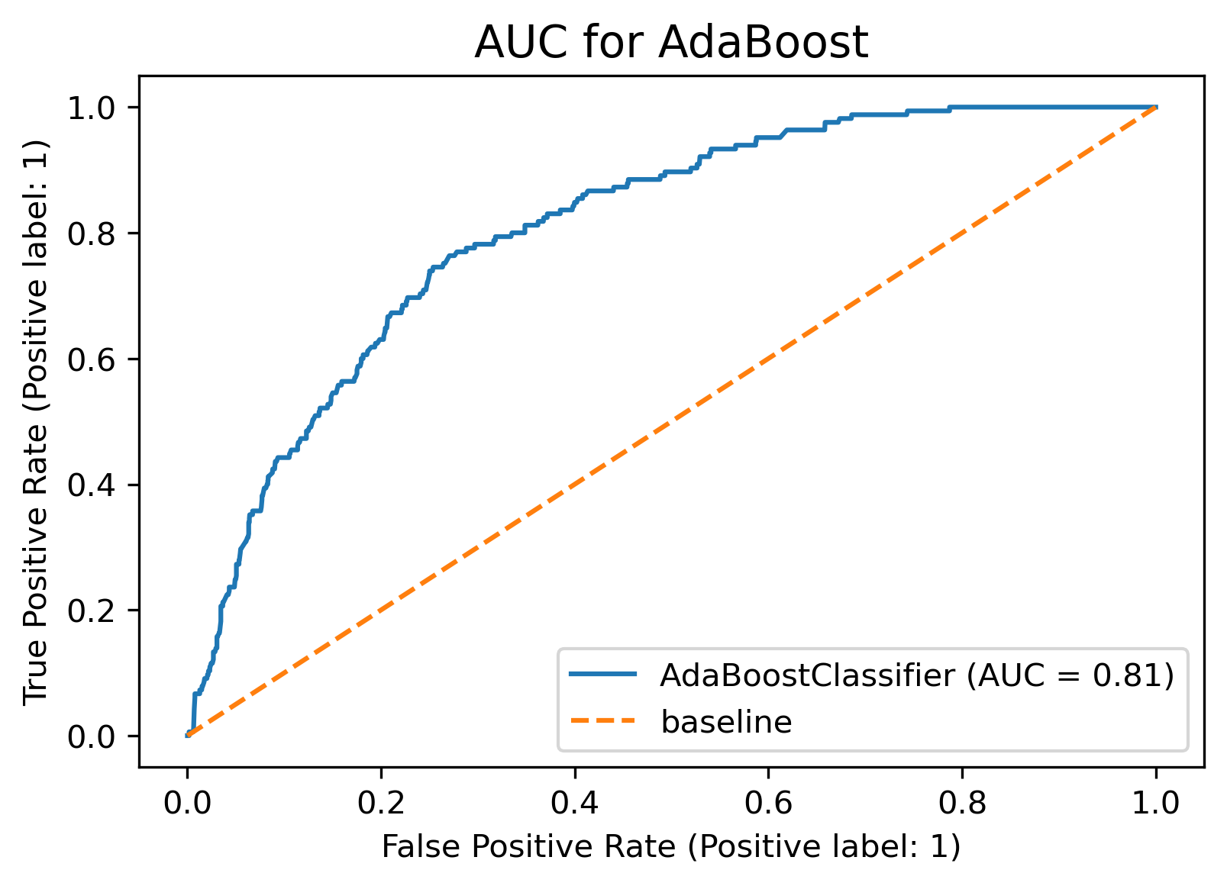
AdaBoost
Area Under Curve
AUC closer to 1
Better at distinguishing between classes
Better Model
Notes:
Adaboost
AUC is 0.81, higher than the previous 2 models seen, closer to 1
seems like it might be a better model than the previous 2, lets take a look at the F1 score for now

Slide 28
AdaBoost
31%
86%
94%
F1-score
Train Accuracy
Test Accuracy
Used to compare classifier performance
Train and Test Accuracy compared to check for overfitting/underfitting
Notes:
F1 score is at 31%, also pretty low but around the same performance as the models looked at so far
Similar to support vector though, the Train Accuracy is lower than Test Accuracy, suggesting that the model is underfitting, not a good sign

Slide 29
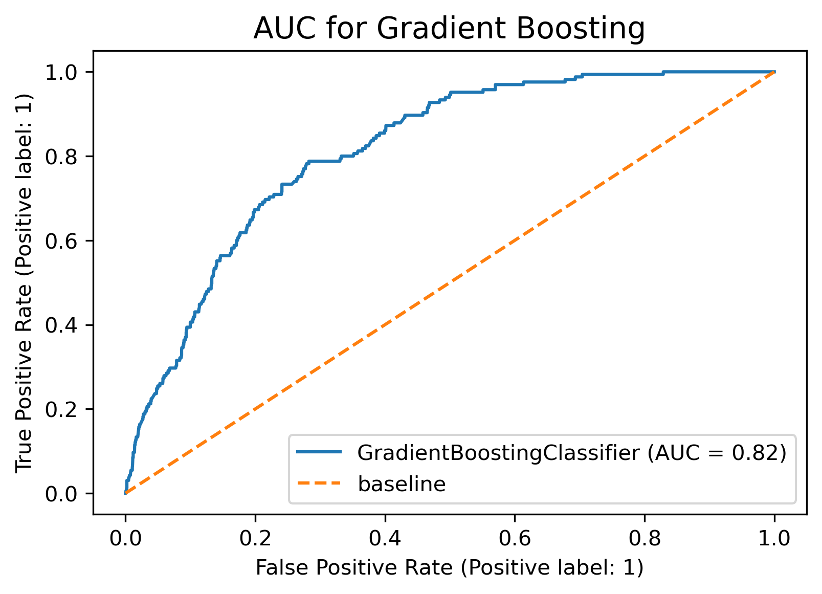
Gradient Boosting
Area Under Curve
AUC closer to 1
Better at distinguishing between classes
Better Model
Notes:
Gradient boosting
AUC of 0.82, seems like the AUC for all the models are around the 70-80% range, but this is the highest of all models

Slide 30
Gradient Boosting
34%
90%
94%
F1-score
Train Accuracy
Test Accuracy
Used to compare classifier performance
Train and Test Accuracy compared to check for overfitting/underfitting
Notes:
F1 score is 34%, still low, but the best of all models
Train Accuracy is slightly lower than Test Accuracy, suggesting slight underfitting but not too bad

Slide 31
Models Summary
 | AUC | F1-score | Train Accuracy | Test Accuracy
Random Forest | 76% | 31% | 95% | 94%
Support Vector Classifier | 80% | 29% | 83% | 95%
AdaBoost | 81% | 31% | 86% | 94%
Gradient Boosting | 82% | 34% | 90% | 94%
Notes:
4 models are random forest, support vector classifier, adaboost, gradient boosting
First we compare the AUC, all within 70-80%, with gradient boosting having the highest value of 82%
Next is F1 score, all within 20-30%, not very good, but again, gradient boosting has highest value at 34%
Aside from random forest, all models are underfitting but gradient boosting is the least severe with about 4% difference between the Train and test Accuracy so i wouldn’t be too concerned
Overall we will choose the gradient boosting model since it has the highest value across both AUC and F1, best balance
But the models are not the best and a lot of room for improvement, for example resolving the underfitting issues, improving the F1 score → F1 score is pretty low, we want as close to 1 as possible
Need to further improve the models like further tuning of hyperparameters, underfitting is a tell tale sign, potentially over regularising the models. And definitely need more data, especially data of virus being present. Will move forward with gradient boosting model in the future to finetune it and train it once we get more data

Slide 32

04
Conclusion & Recommendation

Slide 33
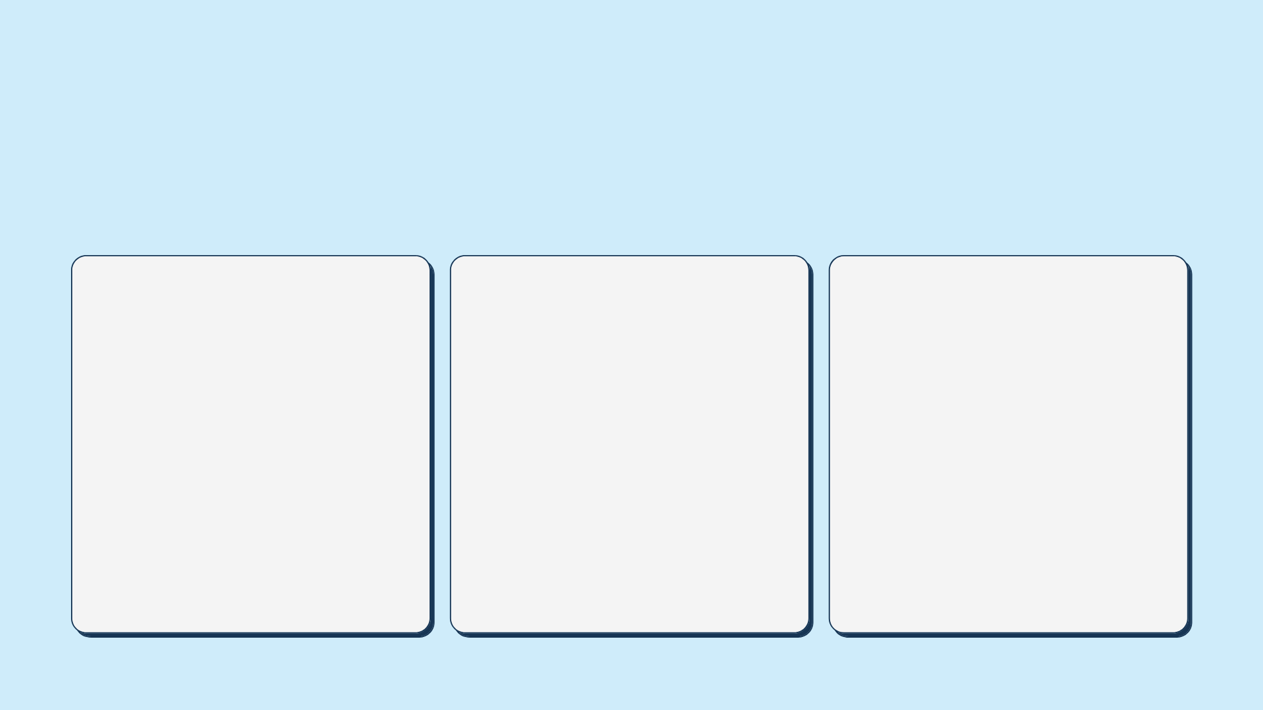



Our goal:
To predict the places in Chicago where the West Nile Virus is present through classification modelling to enable an effective plan in deploying pesticides spraying throughout the city.
Cost-
Benefit Analysis
Conclusion
Recommen-dation

Slide 34

0.82
The Best Model
Gradient Boosting is the best model among our classification models tested.
It has the highest test AUC score of
Other performance indicators:
F1 0.34 | Accuracy 0.94
AUC – ROC curve is the performance measurement for the classification problems. The higher the AUC, the better the model is at distinguishing between the presence of virus or no virus.

Slide 35


Cost Projection
Cost Analysis
(spraying with spray truck)
Based on the classification result of our selected model Gradient Boosting, we will take the percentage of TP, FN, and FP to assume the presence of WNV. This is to ensure all actual positives and predicted positives are covered.
Pesticide: Zenivex E4 (minimum risk to human and non-targeted species)
Cost of Pesticide: USD 227.24 per km²
Cost of full coverage spraying
Test set size = 3152
TP+FN+FP = 618 (20%) see appendix
Taking the total number of traps set up in 2013 ~80, we estimated that we only need to target 17 traps with radius of 2 km each, which will cover about an area of 12.56 km²*,
Entire city of Chicago: 606.10 km²
~ USD 137, 730 each time,
~ USD 1,377,300 twice a month for 5mths
Cost of targeted spraying
Targeted area of Chicago: 213.5 km²
~ USD 48, 516 each time,
~ USD 485,160 twice a month for 5mths in a year
with overlapped coverage if traps are close to each other.
Legend: TP (True Positive), FN (False Negative), FP (False Positive)
Note: *According to CDC, Culex mosquitoes can fly up to 3km²

Slide 36


Benefit Projection
If the West Nile Virus is eliminated, or significantly reduced with effective approaches, this will certainly give the residents a peace of mind.
Quality of life
Risk of
monetary loss
Eliminate fear of
body damage
Fewer people falling ill or dying
Higher productivity at work
Hospital bill can be avoided, ~ $25K per patient
Loss of income or labour during recovery ~ $1.5K/patient* can be saved
Prolonged fatigue
Severe neuro-invasive diseases, such as meningitis
(Peterson, 2019)
20 persons’ monetary loss >
cost of spray $485K/year
Note: *per capita income is $37K, if loss of income for 2 weeks will cause $1.5K loss to a personal or to a business
(https://www.census.gov/quickfacts/fact/table/chicagocityillinois/LND110210)

Slide 37
Conclusion
As shown in our cost-benefit analysis, the cost per infection and the overall well being of the city outweigh the total cost of spray. Spraying is necessary, it instills confidence and a peace of mind, at the minimum..
Based on our EDA, it shows that the current spraying schedule was not very effective:
The sprays were done infrequently and during the window of which less favorable for decreasing the breeding of mosquitoes.
We need more details to understand how the spraying was carried out.
The data used for the modelling is grossly imbalanced which may result inaccurate prediction of the virus.
Should there be an outbreak of virus, people would be subjected to mental health illness, or even death, as there is no effective medication.

Slide 38

Recommendation
Further hyperparameters tuning of the model.
More data is required, preferably a more balanced dataset.
Explore other modelling techniques
Explore Wolbachia (Singapore) Mosquito Suppression Strategy (with care)
When male Wolbachia-carrying Aedes aegypti (Wolbachia-Aedes) mosquitoes mate with urban female Aedes aegypti that do not carry Wolbachia, their resulting eggs do not hatch.
Lavriciding technique
Uses biological pesticides, chemicals or fish to kill mosquito larvae in waters before they hatch
More traps to be placed near Farmer Market
Areas where birds and humans would gather, thereby drawing mosquitoes, especially in the summer.

Slide 39
Thanks

Slide 40
Data Cleaning & Preparation
Train | Dataset from Kaggle and was exceptionally clean | Converted date to datetime for further processing
Spray | Dataset from Kaggle had missing time values | Removed as it only affected 4% of dataset
Weather | Dataset from Kaggle had no null values but had imputed values for null | Converted date to datetime for further processing Cleaned wrongly imputed values
Engineered
Codesum: As not all weather conditions were available, we grouped the remainder into wet or dry variables
Date: Created YearMonth and YearWeek, to see if the months and weeks had any correlation with the virus

Slide 41
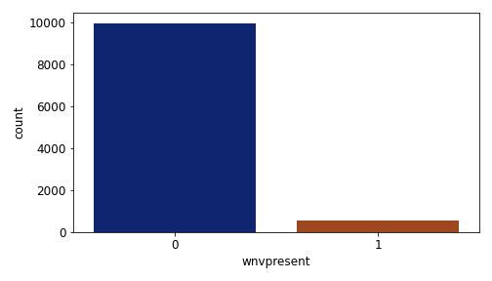
EDA: WNV Presence
Negative
~95%
Positive
~5%

Slide 42
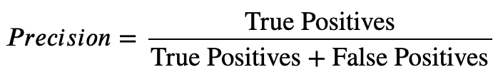
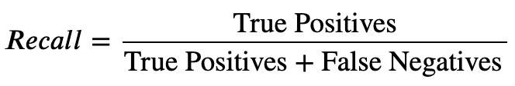
Precision-Recall
Precision
Ratio of True Positives to All Predicted Positives
High Precision = More number of places predicted as virus-present actually does indeed have the virus
Recall
Ratio of True Positives to All Actual Positives
High Recall = More number of places that actually have the virus present is correctly classified by model
Notes:
Additional slide in case anyone ask what is precision and recall

Slide 43
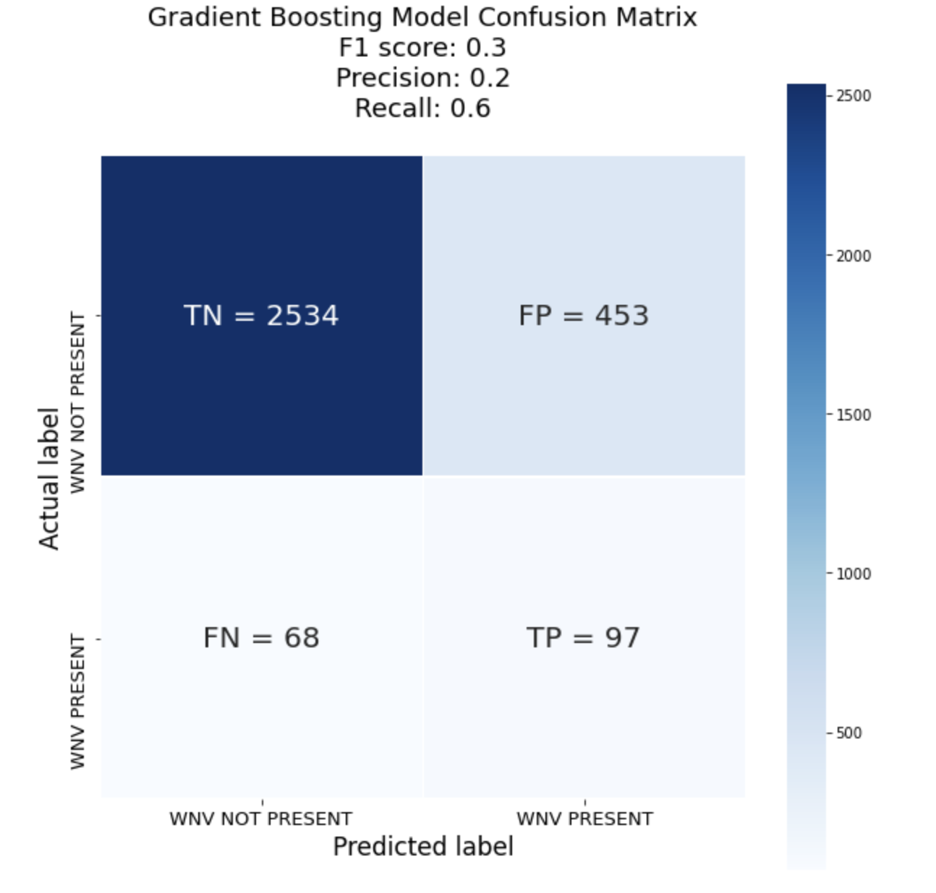
Confusion Matrix
Of Gradient Boosting Model
Notes:
Additional slide in case anyone ask what is precision and recall

